Slide 1
Background: stream ciphers

Slide 2
Practical ciphers
Two major categories
STREAM ciphers
Traditional (weak): RC4
Modern (strong): Salsa20, ChaCha20
BLOCK ciphers
Traditional (weak): DES, 3DES
Modern (strong): AES
Plus BLOCK ciphers used in STREAM mode
AES-CTR

Slide 3



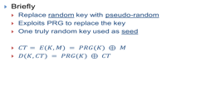











Stream ciphers
E(m, k’)
D(CT, k’)
M
CT
M
PRNG(k)
PRNG(k)
k
k
Goal: “approximate” a one-time-pad
Crucial difference:
One Time Pad → random key
Stream cipher → random keystream
DO NOT confuse key K with keystream k’!!!!
Graphics courtesy of Marco Spaziani Brunella

Slide 4
Stream ciphers
E(m, k’)
D(CT, k’)
M
CT
M
PRNG(k)
PRNG(k)
k
k
ENC and DEC based on XOR (exactly as OTP)
CT = ENC(K, M) = M ⊕ keystream = M ⊕ PRNG(K)
M = DEC(K, CT) = CT ⊕ keystream = CT ⊕ PRNG(K)
If substring repeats, ciphertext changes (good!)
C I A O C I A O C I A O ⊕ 1 3 4 f 2 5 9 5 8 d d 1 = α β η δ ϕ φ τ κ σ δ λ λ
Graphics courtesy of Marco Spaziani Brunella

Slide 5
Stream ciphers
E(m, k’)
D(CT, k’)
M
CT
M
PRNG(k)
PRNG(k)
k
k
Still, if message is encrypted twice, ciphertext will repeat!
PRNG is deterministic! same input (key K), same output (keystream K’)!
RC4 example:
Encrypt “giuseppebianchi” → CT = giuseppebianchi ⊕ RC4(key)
Key = 12345678790 → CT = 474d4caf78a844afa8b29add814e86
Key = 12345678791 → CT = d291ee1272acdb9e9e982986dfb4f8 - different key: ☺
Key = 12345678790 → CT = 474d4caf78a844afa8b29add814e86 - same key: ☹
Problem: with static key, IND-CPA breaks!
Question: how to guarantee semantic security?
Graphics courtesy of Marco Spaziani Brunella

Slide 6

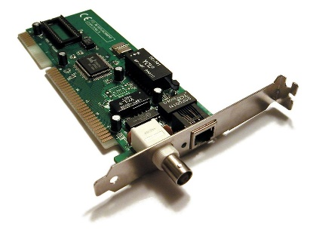
Initialization Vectors in stream ciphers
Plaintext MSG
Plaintext MSG
Plaintext MSG
⊕
IV
ciphertext MSG
ciphertext MSG
IV
⊕
PRNG(K || IV)
K
IV
PRNG(K || IV)
K
Initialization Vector IV → fresh PRNG seed at every new msg
IV (usually) transmitted in clear, along with ciphertext
RX combines it with long term key → reconstruct keystream
Provable semantic security… but only if IV will NEVER REPEAT!!

Slide 7
Main thesis of this (entire!) class: Good crypto can be badly used Most breaches exploit poor protocol constructions and/or vulnerabilities Warm-up example 2 802.11 WEP

Slide 8
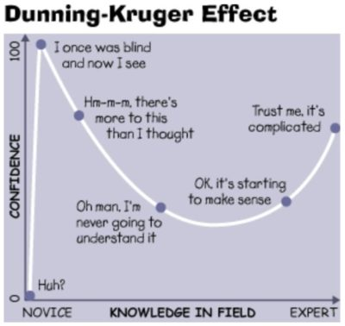
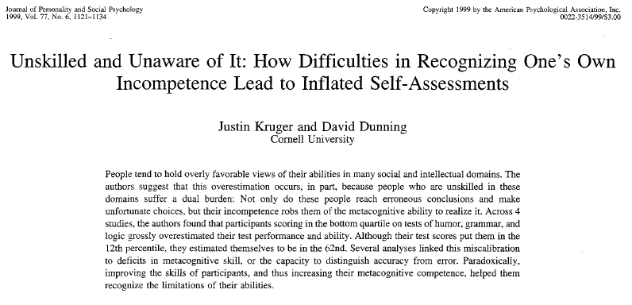
Preamble: a MUST-KNOW fact of life…
The incompetence of unskilled people robs them of the metacognitive ability to realize that they are incompetent
→
Ignoring of being ignorant
a.k.a the dictature of ignorance
Plenty of real world examples! In politics, media, school, work, working groups,…
Wish I were here..☺

Slide 9
WEP lessons
Good cipher is far from being enough
You must make good USAGE of cipher
And you must design GOOD protocols
WEP goals
Authentication Ridicolous! Facilitates attack!
Integrity Inconsistent!
Confidentiality Broken!
WEP: best “real world” example of how to make things incredibly (!) wrong
And well «besides» its weak cipher (RC4)

Slide 10
WEP cipher: RC4
RC4: a specific PRNG algorithm
used to generate the keystream
Today weak, but still considered to be strong at that time
Important WEP lesson: WEP confidentiality broken even if RC4 were perfect!
RC4 weaknesses “just” make the situation worse…
RC4 encryption:
ENC(KEY,MSG) = MSG ⊕ RC4(IV, KEY)
Keystream = RC4(IV, KEY) intuitively consider this as PRNG(IV, Key)

Slide 11
Wep and IV
WEP: Per-frame IV (a must in WLAN)
Stream cipher must be synchronized
BIG problem in lossy channels
WEP solution: send IV per each frame
Can independently decrypt each frame irrespective of previously received/missed ones
WEP IV: transmitted in clear
Not a problem in any good stream cipher: even if IV known, this should not break security
Security should ONLY require secrecy of the key
Keystream = PRNG(IV,Key); if IV known key remains unknown

Slide 12
WEP and IV
If we assume RC4 strong, then WEP secure as long as IV never repeats
Indeed, same keystream iff same (Key, IV)
{ks_{i}} = PRNG(IV,Key)
If IV repeats, no more semantic security
(M1 ⊕ ks_{i}) ⊕ (M2 ⊕ ks_{i}) = M1 ⊕ M2
If one message known, other known
If IV repeats, the weakness is PRACTICAL!!
Easy to create a KPA or CPA condition in wifi
Even without KPA, Limited message entropy → helps to infer
“context” information → helps to infer

Slide 13


And since IV is sooooooo important….
WEP incredible blunders:
IV size = 24 bits
IV generation: left to the implementation [never, NEVER, do this in security protocols!!]

Slide 14
Repeating IV in WEP
Cyclic generation {1,2,3,…}?
24 bit → 2²⁴ cycle = 16.777.216 frames
Assume:1500 bytes frames, ∼7 mbps (net) wifi throughput
IVs re-cycle after less than 8h!
Random IV generation?
Birthday paradox!
50% collision probability after approx 2¹² = 4000 frames!
Restart after reboot?
In many cases, IV re-start from 0! Same IV sequence!!

Slide 15
Practical attacks to small IV space
Passive attack: create dictionary
IV → RC4(IV,Key)
How to? Use known messages to recovery keystream
(MSG ⊕ RC4(IV,key)) ⊕ MSG → RC4(IV,key)
Known messages?
Send an email with large known attachment ☺
Use…. AUTHENTICATION PROCEDURE!!
See next 4-5 slides!!
Wait for IV to repeat: game over
(M’ ⊕ RC4(IV,key)) ⊕ RC4(IV,key) = M’
Larger WEP key size (e.g. 128)?
Irrelevant: IV still 24 bits!! Same attack time!!

Slide 16
Well, things get even worse weak chosen cipher
Cryptoanalytic attack to RC4
Fluhrer, Mantin, Shamir: show weakness
Some “weak” IVs leak key information into keystream
With 5% probability, a byte in the keystream is equal to a byte in the key
Look at many packets and see where bias is
Stubblefield, Ioannidis, Rubin use weakness
Focus on first keystream byte
BUT this is even known for ALL packets
Remember: 802.11 uses SNAP LLC encapsulation: first byte = 0xAA
Known plaintext!
Attack linear (!) with key size

Slide 17
User authentication
Prove that you are really the one you claim to be
Do not confuse:
Identification → show your «digital identity» (email, ID)
Authentication → prove your digital identity is controlled by you (e.g. you know a secret password)
Actually, not so simple…
There might be no requirement to link identifier to a real-life identity
Successful authentication = I’m reasonably assured that the subject accessing the service today is the same as the one which accessed the service in the past.
NIST SP 800-63-3 definition for digital user authentication: the process of establishing confidence in user identities that are presented electronically to an information system

Slide 18
Authentication Means
Something you (and only you) know
Password, PIN, secret key, answer to a pre-arranged question, …
Something you (and only you) have
Smart card, Physical devices (tokens)
Very interesting area: “authentication” based on HW uniqueness → PUF (Physically Unclonable Function)
Something you are (static biometrics)
retina, fingerprint, face, …
Privacy? And what about DNA (Remember Gattaca?)?
Something you do (dynamic biometrics a.k.a. behavioral authentication)
Voice recognition, hand writing, typing characteristics
… even Mouse Movements!!
But there are also other specific means harder to classify, e.g. location-based auth

Slide 19
WEP authentication
Grant network access only to users who KNOW a pre-shared secret
A DIFFERENT security goal (service) than confidentiality!
How to “prove” I know a secret?
By revealing it while accessing the network?
Nah…
anyone else would overhear it
And would use it later on (replay attack)
Perform some operation which REQUIRES knowledge of the secred
But whose result does NOT reveal it!

Slide 20
WEP idea:
Secret: use the SAME of encryption
Minimize «secrets» to handle
In principle might even make sense…
But you MUST know how to properly handle this more in a month from now!
Operation: Challenge-Handshake with symmetric cipher
Prove knowledge of K by showing ability to encrypt the challenge
Challenge
ENC_{K}(Challenge)

Slide 21

It is a good approach?
Challenge
ENC_{K}(Challenge)
Let’s check the Menezes book:
Yes, chapter 10.3.2 mentions this
As long as challenge random and never repeats, I’m OK then
SURE???

Slide 22
Why WEP “authentication” helps?
WEP details
Same key as frame encryption (!)
Challenge = plaintext = known
Isn’t this a Known Plaintext Attack??!!!!!
Challenge
IV, Challenge⊕RC4(IV,K)

Slide 23

Why WEP “authentication” helps?
Rogue AP: send multiple challenges
Gather multiple [IV, RC4(IV,K)] pairs!!
When enough, go and enjoy decrypting anyone else in the BSS!
Challenge
IV, Challenge⊕RC4(IV,K)

Slide 24
But at least is WEP “authentication” robust??
No, its broken as well!! No need to know key to enter network!
JUST one [IV, RC4(IV,K)] pair → game over!
Why?
Because… IV chosen by… responder!!!
Challenge
IV, Challenge⊕RC4(IV,K)

Slide 25
Why WEP “authentication” helps?
And if no IV available and no active attack possible?
Just eavesdrop ONE authentication!!
Challenge
IV, Challenge⊕RC4(IV,K)
Challenge known → derive RC4(IV,K)
IV in plaintext
One pair ready to be used for YOUR authentication!

Slide 26
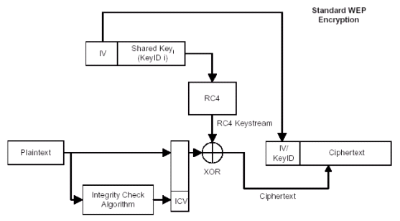
WEP – summary (so far)
(IV, shared key) used as RC4 seed
Must never be repeated (why?)
There is no key update protocol, so
security relies on never repeating IV
24 bits
40 bits
IV sent in the clear: not a big issue.
Rather: changing IV with each packet is… optional!
CRC-32 checksum is linear in ⊕:
if attacker flips some plaintext bits, he knows which
bits of CRC to flip to produce the same checksum
no integrity!
Source: V. Shmatikov

Slide 27
What about integrity?
“Terrific” idea: use native CRC-32 as integrity check value
External encryption wrapping should prevent (!) attacker to perform valid alterations
Problem: CRC-32 is linear!
c(A)⊕ c(B)=c(A⊕B)
Deadly: use only cryptographically strong algorithms
Consequences:
(Meaningful!) Message modification
Message injection

Slide 28

Message modification
IV; C = [M|C(M)] ⊕ RC4(IV,K)
Chooses δ as long as M
Computes c(δ)
Computes:
C’ is an encrypted message with valid CRC32!! Fooled!
NO NEED to know M
δ can be chosen so as to flip specific bits

Slide 29
Message injection
Obtain one pair IV, RC4(IV,K)
Goal: inject message M so that it is authenticated and encrypted
Steps:
Compute c(M)
inject IV, RC4(IV,K) ⊕[M|c(M))
Take-home messages:
1) integrity check must be NON LINEAR
2) Integrity check must explicitly include a key
external encryption may not provide ANY guarantee

Slide 30
802.11: Aftermath
Optimized WEP attacks on many open source
Although just very few WEP protected networks remaining
WiFi evolution (802.11i):
WPA: retain hardware compatibility (RC4), but patch with:
Longer IV (48 bit)
Protection of IV (plaintext differs from RC4 input)
Ephemeral key derivation (changing in time)
…
WPA2: as above but using AES (new hardware)
2017: discovered KRACK attack to WPA2
Note: attack works against a mathematically proven secure (!) 4-way handshake… OUCH!
2018+ → WPA3 standardized

